Slide 1
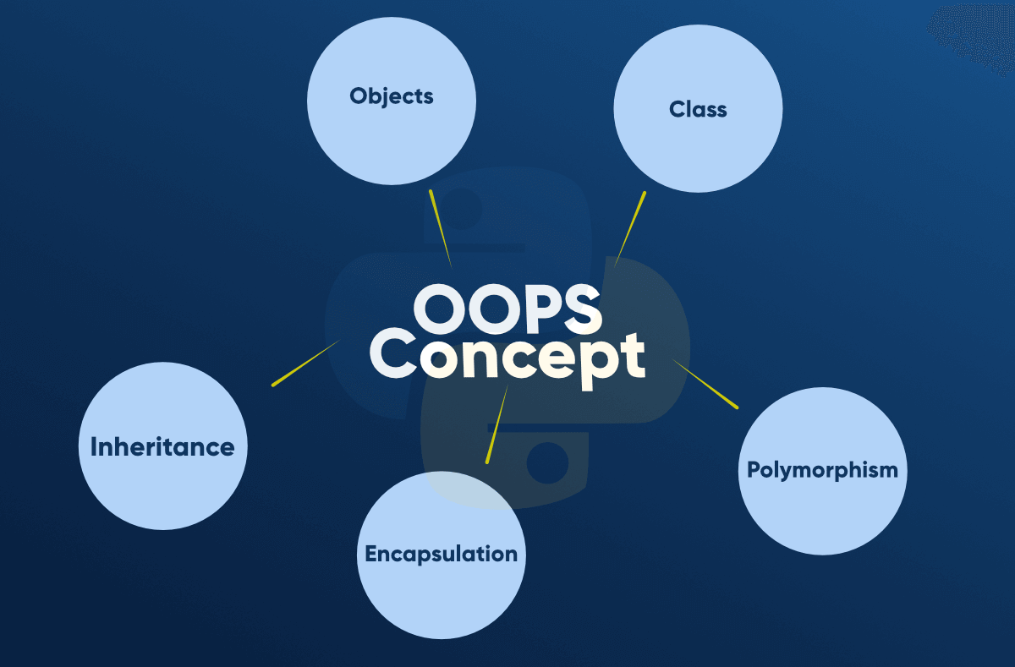
OPPS
In Python, object-oriented Programming (OOPs) is a programming paradigm that uses objects and classes in programming.
It aims to implement real-world entities like inheritance, polymorphisms, encapsulation, etc. in the programming.
The main concept of OOPs is to bind the data and its associate functions together as a single unit.

Slide 2
OPPS
Class :
A class is a collection of objects or you can say it is a blueprint of objects defining the common attributes and behavior.
Object :
Objects are an instance of a class. It is an entity that has state and behavior. In a nutshell, it is an instance of a class that can access the data.
Encapsulation :
Encapsulation is one of the fundamental concepts in object-oriented programming (OOP). It describes the idea of wrapping data and the methods that work on data within one unit.

